Slide 1
10 Best Practices for Writing Your Dissertation
A quick and handy reference guide with tangible steps you can take to complete your master level dissertation easier. This presentation is a condensed version of a post published on the Ultius blog.
Full post link: https://ults.co/2ep8MTK
Copyright © Ultius, Inc.
October 18, 2016

Slide 2
01
CHOOSING THE RIGHT TOPIC
You are going to be stuck with this project for a long time. Take your time and make sure to pick a compelling topic that will get you through the long process.
DO THIS DON’T DO THIS
GENUINE INTEREST
BROAD TOPICS
Pick something you have a real interest in, like issues you care about.
Narrow down your focus within a discipline so that you hit your mark when done.
ORIGINALITY
NO PREVIOUS RESEARCH
Choose a topic that is unique and not over saturated by other scholars.
Be original, but make sure your topic has previous research so you have evidence.

Slide 3
02
KNOW THE STRUCTURE
When it comes to creating a structure (or format) for your document, don't re-invent the wheel. Stick with working on each section as described below.
Structure of a dissertation
Initial proposal
Introduction
Literature review
Methodology
Body chapters
Results and discussion
Conclusion
References and appendix

Slide 4
03
CREATE AN OUTLINE
Plan out your work accordingly into a neat outline so that you know what sections you have to work on and the overall scope of the project.
Let your adviser review it to let you know if you are on the right track.
My Outline
I. Introduction
a. Background information
b. Thesis overview
II. Literature Review
a. Source #1
b. Source #2
III. Methodology
IV. Results
...
Be like the solar system and "plan-et" out. Seriously, no great dissertation was ever written without a good plan of attack.
Be as thorough as possible and indicate exactly what you are going to write about in each section by adding a brief description for each section.

Slide 5
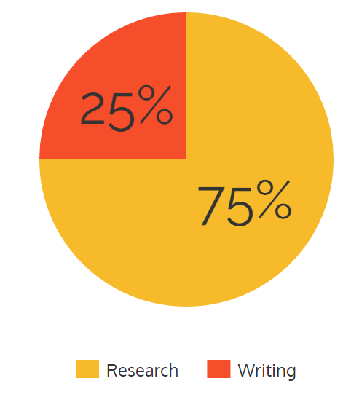
04
CONDUCT PROPER AND THOROUGH RESEARCH
The majority of your time (75%) should be spent doing research on your topic. If you do this part right, the writing portion will be easier.
TIME ALLOCATION CHART
BEST SOURCE DATABASES
Use these resources to get started.
Google Scholar
EBSCOhost
JSTOR
Campus library
ProQuest
Primary research*

Slide 6
05
COMPILE SOURCES AS YOU GO
You are going to be stuck with this project for a long time. Take your time and make sure to pick a compelling topic that will get you through the long process.
USING NOTECARDS
DEVELOP A SYSTEM
For every source, make a notecard with all of the relevant information about the source as well as how you plan to use it in your research.
However you compile sources, do it on the fly and don't be afraid to develop your own system. Just make sure to stick with it.
SAVE “QUOTABLE” MATERIAL
DON’T WAIT
As you go through each source, collect and organize quotes you can use to cite research later. Paraphrase the information used.
DO NOT wait until you are done writing to compile your sources. You will lose precious time.

Slide 7
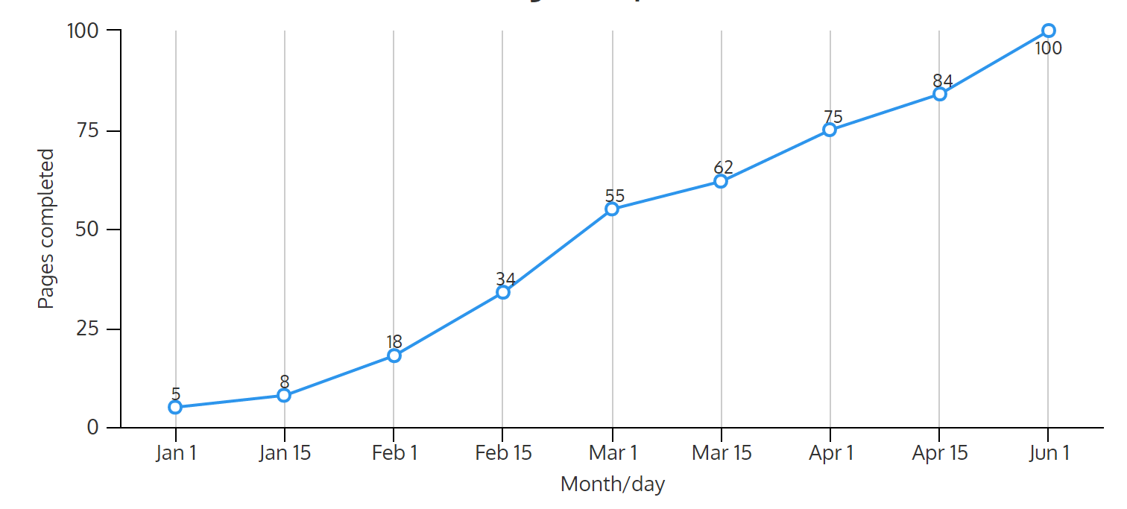
06
MANAGE TIME BY TRACKING PROGRESS
Managing your time wisely is the best practice you can follow while writing your dissertation. But remember that an activity cannot be managed until it is tracked!
DISSERTATION COMPLETION CHART
Consider making an Excel spreadsheet that tracks your completion (in pages) by the day.
This way, you can track real progress and work on your velocity.

Slide 8
07
OVERCOMING WRITER’S BLOCK [TO-DO]
Inevitably, you will face writer's block at some point. It's important to overcome this temporary obstacle by doing the right things and staying positive.
TAKE BREAKS
REMOVE DISTRACTIONS
Take breaks every 50 minutes. Go on walks, get coffee, phone a friend or take a nap.
Concentrate by setting your phone on airplane mode and disable Wi-Fi on your computer.
LISTEN TO MUSIC
GO OUT
Lift yourself up with some classical music or other groovy tunes. It will boost your spirits.
Go out with friends and family to clear your head until you are ready again.

Slide 9
07
OVERCOMING WRITER’S BLOCK [NOT TO-DO]
While you are dealing with writer’s block, it’s important to avoid certain coping mechanisms that may not be so good for you, according to various studies.
AVOID WRITING
SELF-PITY AND ANGUISH
Don't force yourself to write if you are really stuck. You will grow bitter and resent the work.
Don't be hard on yourself, writer's block happens to everyone. Focus on positive coping methods.
WATCH TV
WAIT FOR 'INSPIRATION'
TV distracts you in a way that is not productive for helping you get back on the horse.
Inspiration comes from being engaged in the process and thinking critically, not waiting.

Slide 10
08
HAVE A SUPPORT SYSTEM IN PLACE
As you are preparing for a long road towards your master's degree make sure to take advantage of your other resources. Things will get tough and you won't be alone.
FAMILY
FRIENDS
Tell your loved ones ahead of time that you are working on a major milestone and you need their support.
Make sure that your friends respect your time, life choices and overall commitment to getting the work done.
ADVISERS
PROFESSORS
Your adviser has been there before and knows what to do if you get stuck and need help.
Professors can give you both practical and emotional support if you open up and ask them to.

Slide 11
09
SECURE GOOD FEEDBACK
Avoid having to 'backtrack' and re-do work by getting feedback along the way. You have many free and paid resources available to help you.
PROFESSOR OR ADVISER
Always try and secure good feedback from people you trust.
Be careful with having friends edit your work because they may not have the experience.
Consider working with an Ultius dissertation editor. We have seasoned professionals ready to help.
CAMPUS WRITING LAB
FRIEND OR PEER
EDITING SERVICES

Slide 12
10
KEEP THE PASSION IGNITED
Keep your passion going strong by finding an inspiring mentor or notable figure, remember why you picked this topic, ditch your comfort zone and have fun!
FIND A MENTOR
REMEMBER THE ‘WHY’
Have a trusted mentor in your field to inspire you to keep going and reach higher.
Recall why you picked your major, your topic and your life path - these feelings will light the way.
NO COMFORT ZONES
HAVE FUN
Push your limits and challenge yourself every week by going deeper into your work.
Stay positive and have fun because you are doing what most people won't (or can't).

Slide 13
ADDITIONAL READING
If you enjoyed this presentation on dissertation best practices, make sure to explore these additional resources.
GOOGLE DOCS VS MS WORD – COMPARISON
WHY READING MAKES YOU A BETTER WRITER
Wondering whether to commit to MS Word or Google Docs when doing your writing or researching? We compared the features.
Find out how reading more often can improve your writing (and your dissertation). Explore the latest research from experts on the topic.
Read post
Read post
6 WAYS TO IMPROVE YOUR WRITING
EDITING SERVICES
Clear steps that are guaranteed to improve your writing as whole. This guide is backed up by research and includes visual examples.
To make your dissertation even better, consider working with a dedicated dissertation editor from Ultius. We have specialists in every topic.
Read post
Read more

Slide 14
THE END
That’s it! We hope this guide was helpful for you.

